Slide 1
Generating noisy speech data from clean data in the frequency domain using Deep Learning Methods
Week - 1
Name: Shashank Shirol
University: Manipal Institute of Technology
Duration of the presentation: ~10 mins.

Slide 2
A Brief Introduction to the Problem
Traditional models for Automatic speech recognition (ASR) overfit easily and thus require large amounts of data for training.
Solution: Data Augmentation; acts as a regularizer and helps reduce the overfitting problem.
Old approach: augment raw audio to generate samples
New approach: Apply augmentation techniques to spectrograms of the input audio.
We explore this method since we are working with one instance of clean audio to generate noisy audio.
Note: A Spectrogram is a visual representation of the spectrum of frequencies of a signal as it varies with time.

Slide 3
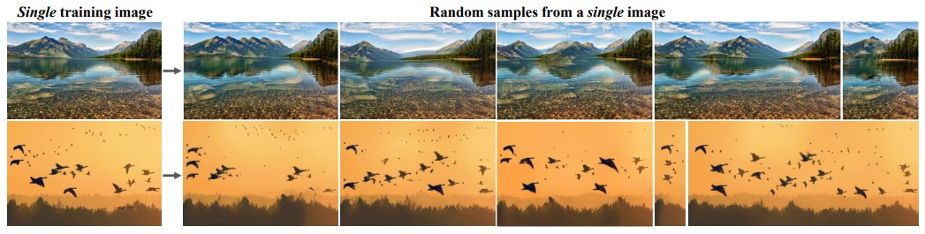
SinGAN: A generative model that learns from a single natural image
SinGAN^{[1]} is a variant of GAN where the network learns from a single natural image, instead of multiple real images to learn representations, as in classical GANs.
SinGAN can learn internal statistics of patches within a single image.
SinGAN has shown impressive results on various image manipulation tasks like – Harmonization, Editing, Super resolution, and Paint to Image (the task we’re exploring).
What SinGAN can Do?
^{[1]} https://arxiv.org/abs/1905.01164

Slide 4
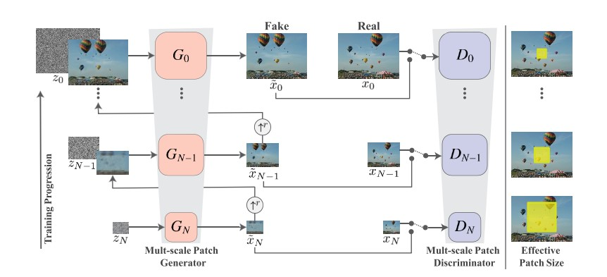
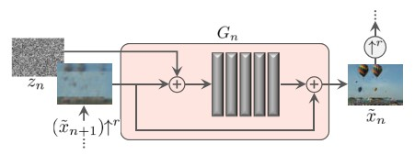
How does SinGAN work?
A multi-scale GAN, has a series of generators and discriminators that are trained one-by-one.
The discriminators are modelled such that it works on patches of the image and not the entire image (to prevent the generator from learning to reproduce the entire image).
Once generators learn to produce good images that “fool” the discriminator at that level, we keep it fixed & move up the level.
Lower level generators learn coarser features and upper layers learn finer features.
Flow of SinGAN generators and discriminators
What makes up a generator

Slide 5
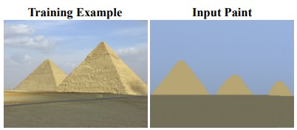
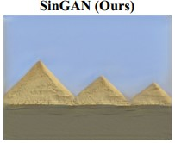
Paint to Image
In Paint-to-image, SinGAN is trained on a target image and use a downsampled paint at the coarse levels at test time.
The generated images preserve the layout and general structure of the clipart while generating fine details that match the training image.
Idea behind using this: we need to generate noisy audio signals from clean ones, here we use the noisy audio as the training image and the parallel clean image as input paint.
Why SinGAN? Because it outperforms other style transfer methods visually and requires one image for training.

Slide 6
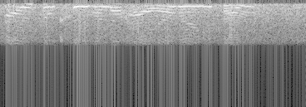

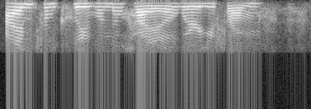
Audio Sample and Spectrogram Used:
Noisy Audio:
Noisy Spectrogram:
Clean Audio:
Clean Spectrogram:

Slide 7
Problems to be tackled
Generating a spectrogram image to feed SinGAN and the resultant image be able to recreate the same audio signal.
To use an appropriate mapping function to map the spectrogram matrix to valid image matrix values (0-255 scale).
To re-convert the image (0-255 scale) generated by SinGAN to represent the spectrogram.
In simpler terms, implement a pipeline for: Audio → spectrogram → SinGAN → spectrogram → Audio

Slide 8
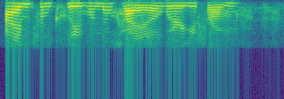
Generating the Spectrogram
This is done by computing the discrete Fourier Transform for real input.
At its core, a spectrogram is a 2D matrix of real numbers that are difficult to represent as an image. One solution is storing the spectrogram with the .tiff extension, which permits such values.
Problem: SinGAN doesn’t work with .tiff images.
Another approach: Use a mapping function that maps a floating point number to a (0-255) scale, which can be used to generate .png files for feeding SinGAN
Pseudocolor plot spectrogram image
.tiff representation of a spectrogram

Slide 9
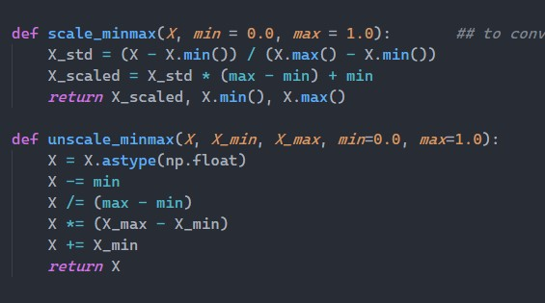
The Mapping(Un-mapping) Function
The scale_minmax function takes a 2D array, min and max value for the bounds. Here, 0 and 255.
The values are mapped as shown in the figure.
Similarly, the unscale_minmax function is used to get the spectrogram representation from the image generated by SinGAN.

Slide 10
Flow of Data:
Extract Spectrogram from an audio file
2D Matrix
Modified Matrix
Mapping Function
Store as .png
SinGAN
Reconstruct Audio from Spectrogram
2D Matrix
Un-mapping Function
Read as Matrix
Spectrogram image generated

Slide 11
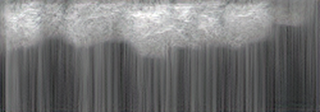
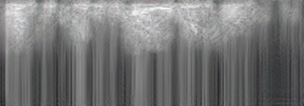



Outputs (for different scales):
1
2
3
4
5

Slide 12
End.

